Slide 1

Wine Site
Harshan(15028422)

Slide 2
Database

Slide 3
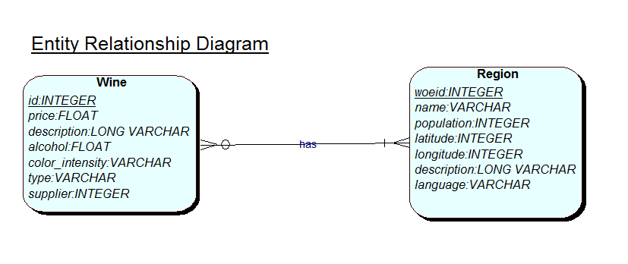
Conceptual Diagram
Notes:
Assumption: one region has zero or more wines. One wine can provide by 1 or more regions.

Slide 4
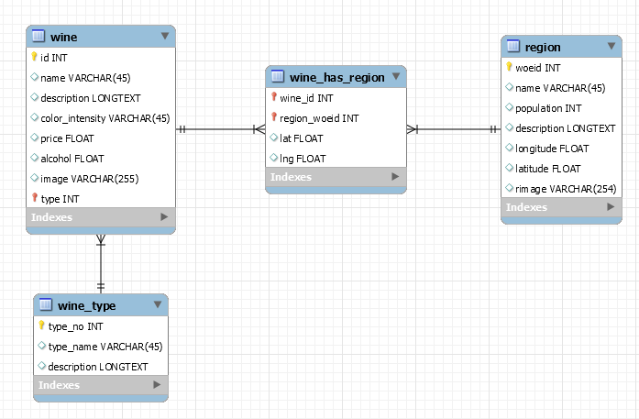
Logical Diagram

Slide 5
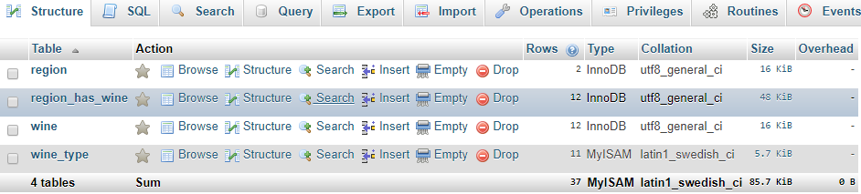
Physical Design

Slide 6
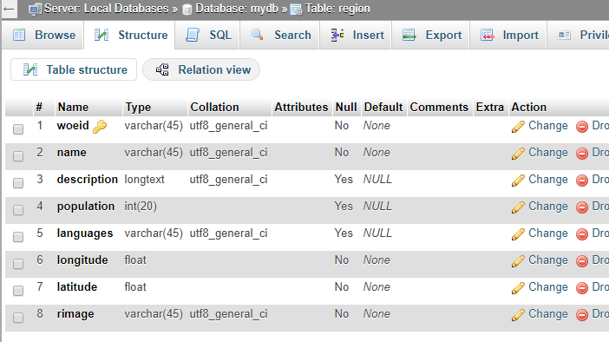

Slide 7
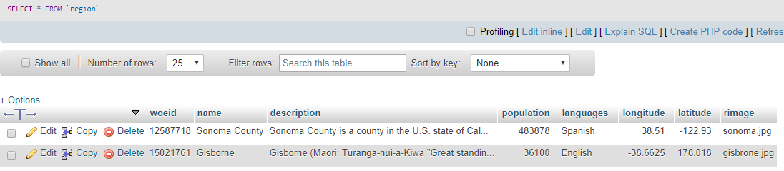

Slide 8
Data Refactoring using NoSQL

Slide 9
SQL vs NOSQL
SQL | NOSQL
Relational Databases | Non Relational Databases
table based | document based, key-value pairs, graph databases or wide-column stores.
predefined schema | dynamic schema for unstructured data
vertically scalable | horizontally scalable
structured query language | unstructured query language
MySql, Oracle, Sqlite, Postgres and MS-SQL | MongoDB, BigTable, Redis, RavenDb, Cassandra, Hbase, Neo4j and CouchDb
good fit for the complex query intensive environment | not good fit for complex queries
not best fit for hierarchical data storage | fits better for the hierarchical data storage
Notes:
1. SQL databases are primarily called as Relational Databases (RDBMS); whereas NoSQL database are primarily called as non-relational or distributed database.
2. SQL databases are table based databases whereas NoSQL databases are document based, key-value pairs, graph databases or wide-column stores. This means that SQL databases represent data in form of tables which consists of n number of rows of data whereas NoSQL databases are the collection of key-value pair, documents, graph databases or wide-column stores which do not have standard schema definitions which it needs to adhered to.
3. SQL databases have predefined schema whereas NoSQL databases have dynamic schema for unstructured data.
Horizontal scaling means that you scale by adding more machines into your pool of resources whereas Vertical scaling means that you scale by adding more power (CPU, RAM) to an existing machine.
4. SQL databases uses SQL ( structured query language ) for defining and manipulating the data, which is very powerful. In NoSQL database, queries are focused on collection of documents. Sometimes it is also called as UnQL (Unstructured Query Language). The syntax of using UnQL varies from database to database.
5. For complex queries: SQL databases are good fit for the complex query intensive environment whereas NoSQL databases are not good fit for complex queries. On a high-level, NoSQL don’t have standard interfaces to perform complex queries, and the queries themselves in NoSQL are not as powerful as SQL query language.
6. For the type of data to be stored: SQL databases are not best fit for hierarchical data storage. But, NoSQL database fits better for the hierarchical data storage as it follows the key-value pair way of storing data similar to JSON data. NoSQL database are highly preferred for large data set (i.e for big data). Hbase is an example for this purpose.

Slide 10
MongoDB
MongoDB is a document database with the scalability and flexibility that you want with the querying and indexing that you need
An open-source document database
written in C++
Built for speed
High Performance
Easy Scalability
Easy readability
Re

Slide 11
MongoDB vs RDBMS
RDBMS | MongoDB
Database | Database
Table | Collection
Tuple/Row | Document
column | Field
Table Join | Embedded Documents
Primary Key | Primary Key (Default key _id provided by mongodb itself)
Database Server and Client
Mysqld/Oracle | mongod
mysql/sqlplus | mongo

Slide 12
Advantages of MongoDB over RDBMS
Schema less − MongoDB is a document database in which one collection holds different documents. Number of fields, content and size of the document can differ from one document to another.
Structure of a single object is clear.
No complex joins.
Deep query-ability. MongoDB supports dynamic queries on documents using a document-based query language that's nearly as powerful as SQL.
Tuning.
Ease of scale-out − MongoDB is easy to scale.
Conversion/mapping of application objects to database objects not needed.
Uses internal memory for storing the (windowed) working set, enabling faster access of data.

Slide 13
Why Use MongoDB?
Document Oriented Storage − Data is stored in the form of JSON style documents.
Index on any attribute
Replication and high availability
Auto-sharding
Rich queries
Fast in-place updates
Professional support by MongoDB

Slide 14
Where to Use MongoDB?
Big Data
Content Management and Delivery
Mobile and Social Infrastructure
User Data Management
Data Hub

Slide 15
Flickr

Slide 16
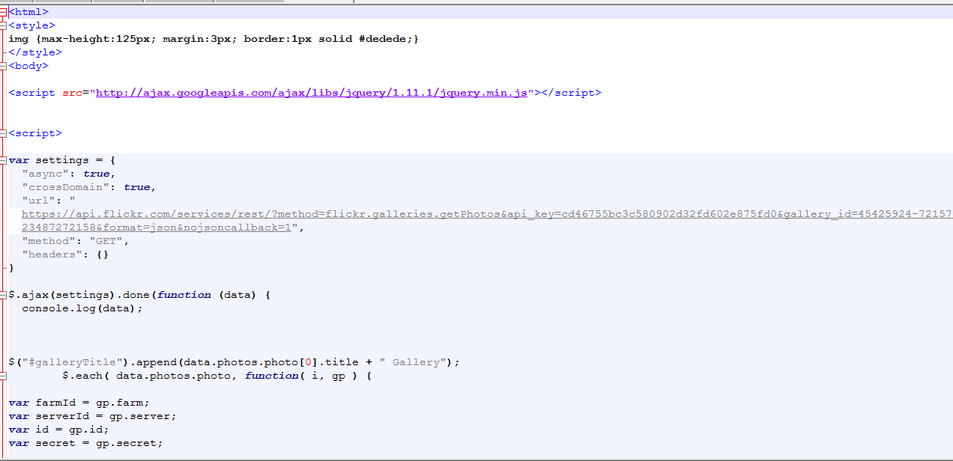

Slide 17
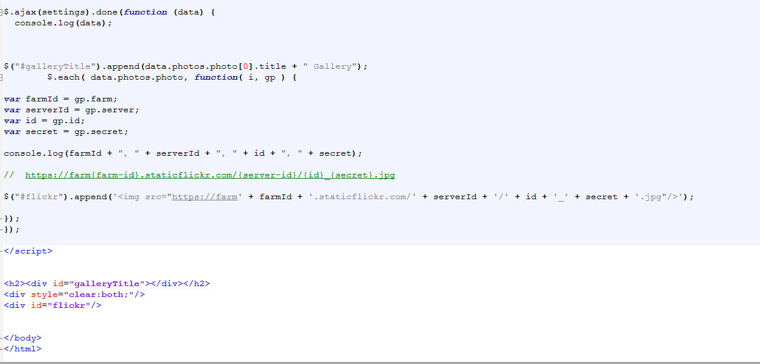

Slide 18
Thank you!

